Slide 1


Data Privacy Workshop
by DE-Data Privacy Protection Cap Centre (DPPCC) Part 2 – Hands On Session 26 Jan 2022
Ameera Adam, Associate Data Engineer
ameera_chumma_adam@tech.gov.sg
Syahri Ismail, Associate Data Engineer
syahri_ikram_ismail@tech.gov.sg

Slide 2
Agenda
Background
Setting Up
Privacy Techniques
Conclusion
Feedback

Slide 3
Background
Provide a basic overview and understanding of data privacy concepts and techniques
There will be hands on python coding to familiarize participants with the available tools and resources of data privacy.
Participants are assumed to have some knowledge on basic python programming and have some experience working with data.
Notes:
This workshop is designed to provide participants a basic overview and understanding of data privacy concepts and techniques, especially from a government agency context.
In the workshop, there will be hands on python coding to familiarize participants with the available tools and resources of data privacy.
Participants are assumed to have some knowledge on basic python programming and have some experience working with data.

Slide 4
Where in IM8?
IM8 Data Protection (Data Security)
1.20: Agencies shall choose at least one of the following technical measures to protect sensitive data and render the data unusable to an attacker even if exfiltrated form storage:
Hashing with salt
Field Level Encryption
Tokenisation
This clause is mandatory for data that meet the following conditions:
Data security risk level: High or Very High; or
Impact level: Very Severe impact

Slide 5
Where in IM8?
IM8 Data Protection (Data Security)
1.21/S1: Agencies shall use the following keys for the technical measures to protect data directly:
Salt value of hashing with salt (Clause 1.20/S1)
Encryption and decryption keys of Field Level Encryption (Clause 1.20/S2)
Mapping of token value of tokenisation (Clause 1.20/S3)

Slide 6




Techniques covered in the Workshop
Hands On
1
2
Hashing
Tokenisation
3
4
Field Level Encryption
Generating Synthetic Data
Concept
K-anonymity

Slide 7

Setting up
Head over to: https://github.com/dsaidgovsg/data-privacy-workshop

Slide 8
Privacy Techniques

Slide 9
Hashing
What’s hashing:
Is the process of converting a given key into another value.
Why perform hashing:
To ensure that the data would not be re-identified to its original form while preserving the dataset uniqueness.
How to perform hashing:
Replace values with an algorithmically derived value that cannot be reversed easily.
HASH function
john
e80b5017098950fc58aad83c8c14978e
raw value
hash value
mathematical algorithm
ONE-WAY function

Slide 10
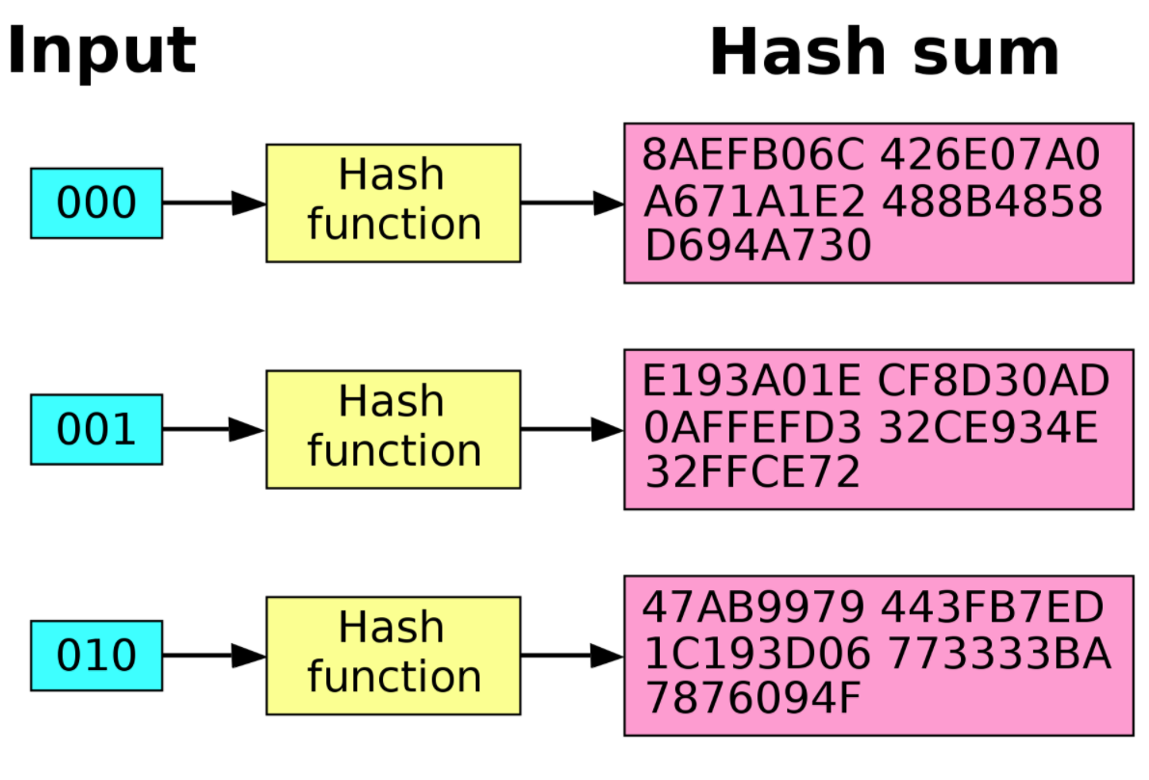
Hashing
Avalanche effect – one bit change can result in a significant change in the resulting hash
Notes:
Characteristic/property of hashing

Slide 11
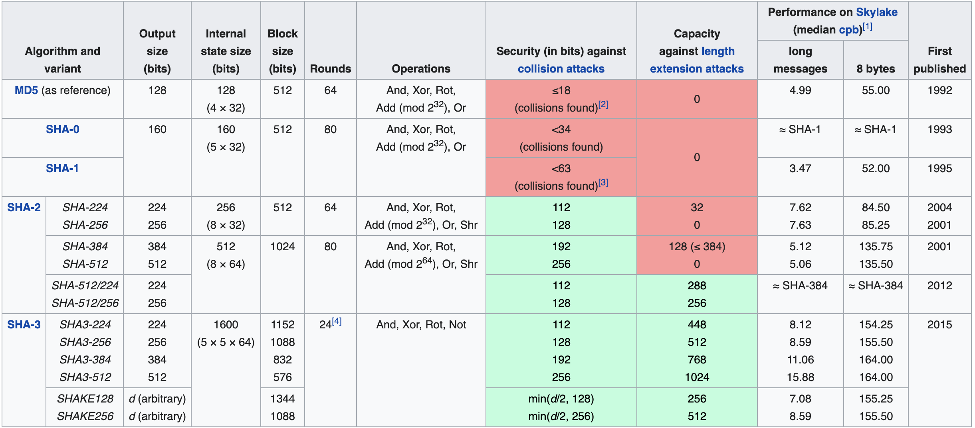
Hashing functions
n-bit security means that the attacker would have to perform 2^{n} operations to break it
Notes:
Lower the number of bits, the more mathematically and technically possible to re-identify the data

Slide 12
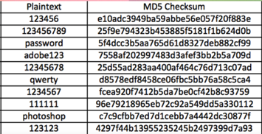
Hashing with salt
Rainbow tables are pre-computed table of password hash chains used to crack hashed passwords
Salting refers to adding random data to the input of a hash
HASH function
passwordgrq9g0n4
39d14515d4d1265e00808c2df143438c
raw value + salt
hash value
mathematical algorithm
Protect against rainbow table attacks!

Slide 13

Code Demo
Hashing

Slide 14
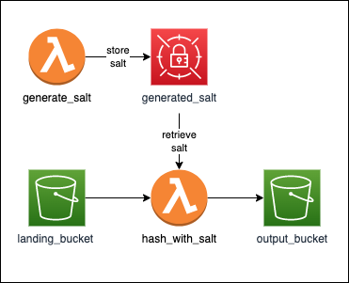
Hashing Cloud Implementation (AWS)
Store the salt in Secrets Manager upon Lambda trigger
Avoid storing the salt in the code (bad practice)
g31bra0gbve
Use two S3 buckets to store clean (unhashed) and hashed data
abcdefghi
59a1bd33567c31baf0811d4da094e765
Note: limitations of Lambda functions
15 minutes execution time
Notes:
Layer of vulnerability if code is exposed (salt in code)
More security can be implemented on landing_bucket, more policies for cleaning, etc.

Slide 15
Tokenisation
What’s tokenisation:
Process of exchanging sensitive data for non-sensitive data called “tokens”
Why perform tokenisation:
To protect sensitive data while preserving business utility
How to perform tokenisation:
Replace identifiers and attributes with a different value known only to the agency. The different values are randomly generated and saved in a lookup table/token vault

Slide 16
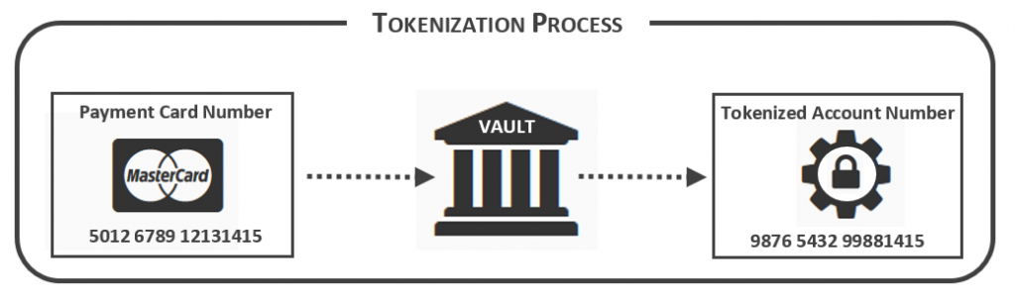
Tokenisation
Randomly generates a token value for each original value and store the mapping in a token vault
Card Number | Tokenized Account Number
5012 6789 12131415 | 9876 5432 99881415
4482 5416 23153931 | 5301 3219 53196410
3531 3421 96216650 | 1492 4219 32191029
Notes:
One-to-one mapping relationship

Slide 17

Tokenisation
Server 1
Server 2
Example Use Case
RAW
create or retrieve mapping
S1234567Z
ingest
transform
NRIC | Token
S1234567Z | 03169319430
S7865432P | 89765434560
S35164631L | 09876545670
NRIC | Token
S1234567Z | 03169319430
S7865432P | 89765434560
S35164631L | 09876545670
Token Table
CLEAN
egress
03169319430
send token
Notes:
Ingest to RAW, transform using tokenisation table and removed from RAW after successfully ingested to CLEAN
If Server 1 is compromised, Tokenisation table will be in the same server, jeopardizing the CLEAN datasets
This gives an option to do detokenization as well (reverse flow)

Slide 18
Code Demo
Tokenisation

Slide 19
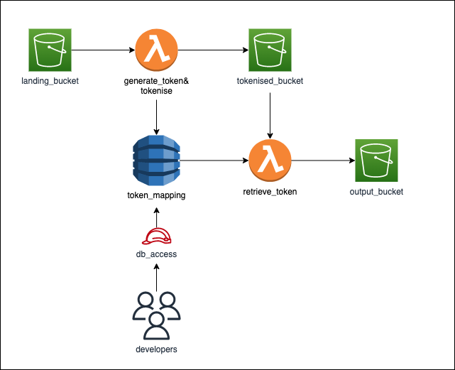
Tokenisation Cloud Implementation (AWS)
Store a token mapping table in a database
Serverless: DynamoDB
Need to ensure that the proper security measures are implemented (IAM)
On reversing the tokenisation (detokenisation), invoke a Lambda Function to retrieve the mapping table and tokens from the database

Slide 20
Field Level Encryption
What’s FLE:
Ensure that sensitive values cannot be seen in the event of a compromise
Why perform FLE:
To protect sensitive data while preserving business utility
How to perform FLE:
Encrypting specific data fields to hide the true value. A different encryption key is used for each field
Notes:
*Note: this measure is only appropriate for data fields where the actual values need not be recovered, such as passwords or for aggregated data analytics. Strong hashing functions should be used, such as cryptographic hash function, that cannot be reversed with current computing resources.

Slide 21
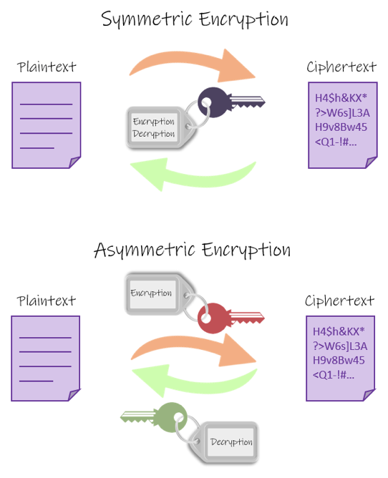
Field Level Encryption
Encryption Basics
Two way functions (i.e. encrypt and decrypt)
Symmetric Encryption
Only one key is used to both encrypt and decrypt
E.g. AES
Asymmetric Encryption
Two keys (key pairs): one key is used for encryption, the other is used for decryption
E.g RSA algorithm

Slide 22
Code Demo
Field Level Encryption

Slide 23
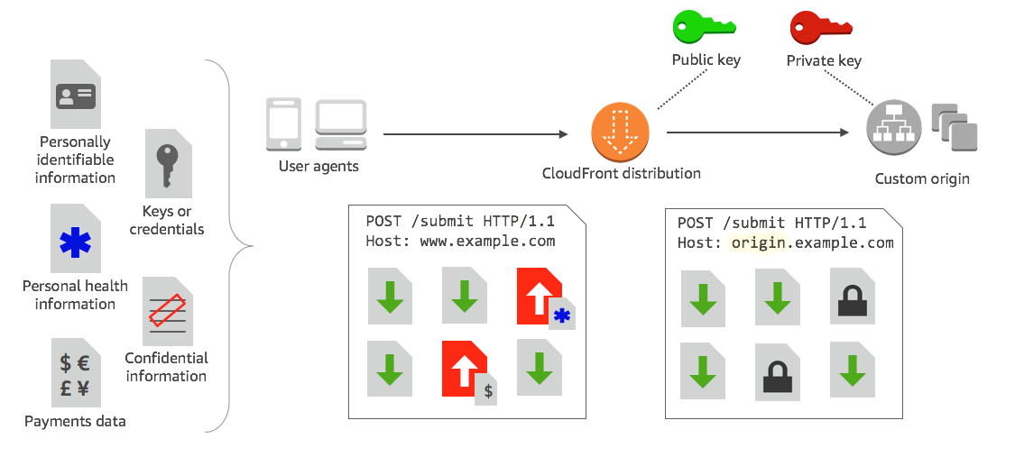
FLE Cloud Implementation (AWS)
AWS Field Level Encryption Blog Post:
https://docs.aws.amazon.com/AmazonCloudFront/latest/DeveloperGuide/field-level-encryption.html
Make use of CloudFront distribution

Slide 24
Synthetic Data Generation
What’s Synthetic Data Generation?:
A repository of data that is generated programmatically that attempts to model the original data but at the same time preserve privacy.
Why generate synthetic data?:
Allows data mining to be done with reduced risk of sacrificing privacy
Notes:
*Note: this measure is only appropriate for data fields where the actual values need not be recovered, such as passwords or for aggregated data analytics. Strong hashing functions should be used, such as cryptographic hash function, that cannot be reversed with current computing resources.

Slide 25
Synthetic Data Generation
Fully Synthetic
Fully synthetic data generators identify the density function attributes in the original data and estimate the parameters of these density functions
For each attribute, privacy protected series are generated by randomly picking up the values from the estimated density functions

Slide 26
Synthetic Data Generation
Partially Synthetic
Partially synthetic data generators replaces only values of the selected attribute with synthetic values
Original values are replaced only if it possess high risk of disclosure
Masking the original values with synthetic values prevents re-identification thus preserving privacy in the published data

Slide 27
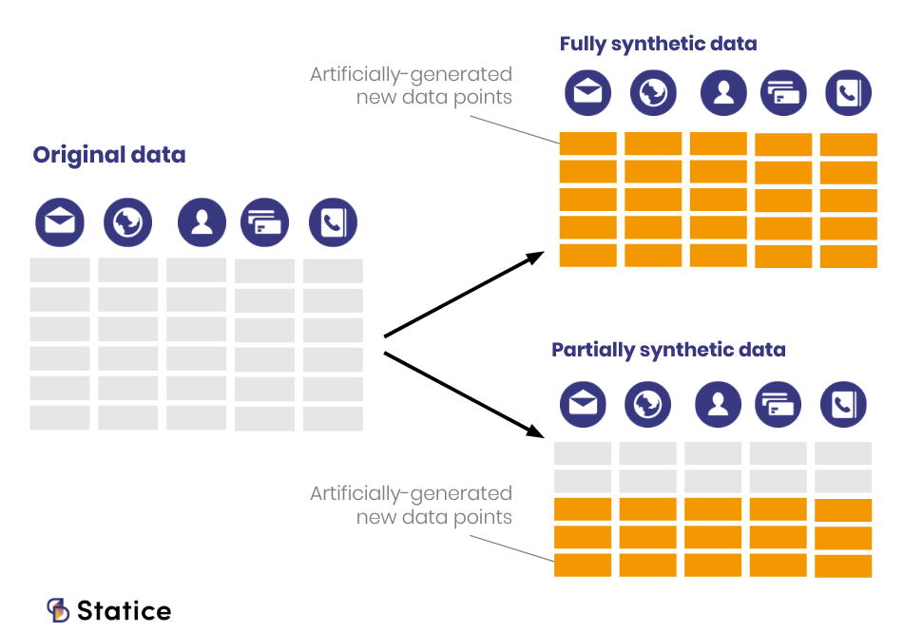
Synthetic Data Generation

Slide 28
Code Demo
Synthetic Data Generation

Slide 29
Application of Synthetic Data Generation in SG
Faker package is more suited towards a US audience (ssn, western names, etc.)
Can still use the package to generate some fields
Credit Cards, Jobs, Datetime, etc.
To generate NRIC/FINs, can use regex to generate a random 7 digit number that is appended to a random alphabet
“S/T/F/G/M” + <random 7 digits> + <random alphabet>
Make sure to run the generated UIN through the NRIC checksum to ensure that it is an invalid UIN

Slide 30
WOG Anonymization Framework
Testing of Re-identification Risk
Re-Identification Test | Details | WOG Access Mode A | WOG Access Mode B
K-Anonymity Test | Used to confirm that the anonymisation measures put in place achieve desired threshold against linking test [Note: Thresholds aligned to Australia’s De-identification Decision-Making Framework.] | Required (Minimally k-anonymous at k=5) | Optional (Minimally k-anonymous at k=3)
Notes:
Reference to Alan’s presentation about IM8 Policies

Slide 31
Scenario for K-anonymity
“Anonymous” Annual Employee Survey
M
M
M
M
Name | Age | Gender | Employer Rating
Alex | 36 | M | 10
Jane | 22 | F | 1
Tom | 54 | M | 7
Anna | 39 | F | 2
M
M
M
M
M
F
Data Generated
M
M
M
M
M
F
M
M
M
M
18 Males, 2 Females

Slide 32
Scenario for K-anonymity
“Anonymous” Annual Employee Survey
M
M
M
M
Name | Age | Gender | Employer Rating
mvMRV019 | 36 | M | 10
pM0g1-vm-9b | 22 | F | 1
r0t1-gr0=vm- | 54 | M | 7
zxTm1v0410v | 39 | F | 2
M
M
M
M
M
F
Data Generated
M
M
M
M
M
F
M
M
M
M
18 Males, 2 Females
Survey Analysis
Average Employer Rating by Gender
Average Employer Rating by Female & Age
Avg Rating
Drilldown
Avg Rating
Management of Department
Male
Female
<35 yr
>= 35 yr
Notes:
Boss of department can see the department survey
Reidentified!

Slide 33
K-anonymity
K-anonymity is a property of a dataset
More risky / higher chances of re-identification
Less risky
1
3
5
10…
∞
K =
0
The “K” value indicates the re-identifiability of its records
Notes:
HIPAA -> look into the different revealing characteristics

Slide 34
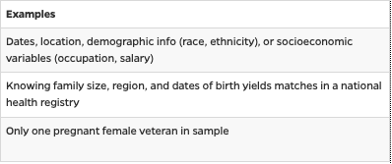
K-anonymity
 | NRIC | Age | Gender | Test Score
1 | $m01vea | 15 | M | 98
2 | 4901-41z | 15 | M | 79
3 | gm94qm | 16 | F | 99
4 | mfea0ev- | 16 | F | 88
5 | gema231 | 17 | M | 82
6 | -319vmd | 17 | M | 90
A dataset is k-anonymous if every combination of identity revealing characteristics occurs in at least k different rows of the dataset
Choose the quasi-identifiers: Age & Gender
Notes:
Health Insurance Portability and Accountability Act HIPAA -> look into the different revealing characteristics
https://guides.library.jhu.edu/protecting_identifiers/definitions

Slide 35
K-anonymity
 | NRIC | Age | Gender | Test Score
1 | $m01vea | 15 | M | 98
2 | 4901-41z | 15 | M | 79
3 | gm94qm | 16 | F | 99
4 | mfea0ev- | 16 | F | 88
5 | gema231 | 17 | M | 82
6 | -319vmd | 17 | M | 90
A dataset is k-anonymous if every combination of identity revealing characteristics occurs in at least k different rows of the dataset
Choose the quasi-identifiers: Age & Gender
Find all different sets of combinations in the dataset for specified quasi-identifiers: {15,M}, {16,F}, {17,M}

Slide 36
K-anonymity
 | NRIC | Age | Gender | Test Score
1 | $m01vea | 15 | M | 98
2 | 4901-41z | 15 | M | 79
3 | gm94qm | 16 | F | 99
4 | mfea0ev- | 16 | F | 88
5 | gema231 | 17 | M | 82
6 | -319vmd | 17 | M | 90
A dataset is k-anonymous if every combination of identity revealing characteristics occurs in at least k different rows of the dataset
Choose the quasi-identifiers: Age & Gender
Find all different sets of combinations in the dataset for specified quasi-identifiers: {15,M}, {16,F}, {17,M}
For each set of combinations, ensure that there is at least K amount of rows.
K-anonymous with K = 2 ? Yes
K-anonymous with K = 3 ? No
Notes:
HIPAA -> look into the different revealing characteristics

Slide 37
K-anonymity
 | NRIC | Age | Gender | Test Score
1 | $m01vea | 15 | M | 98
2 | 4901-41z | 15 | M | 79
3 | gm94qm | 16 | F | 99
4 | mfea0ev- | 16 | F | 88
5 | gema231 | 17 | M | 82
6 | -319vmd | 17 | F | 90
Unique combinations becomes: {15,M}, {16,F}, {17,M}, {17,F}
K-anonymous of 2 ? No
K-anonymous of 1 ? Yes
Being K-anonymous of 1, you can tell with 100% certainty that there is a 17 year old Male that scored 82 and 17 year old Female that scored a 90
Therefore, the higher the K value in a dataset, the higher the level of anonymity is achieved
Notes:
More exercises

Slide 38
K-anonymity vulnerabilities to attacks
 | Name | Age | Gender | Test Score
1 | Alex | 15 | M | 98
2 | Peter | 15 | M | 79
3 | Janice | 16 | F | 99
4 | Maya | 16 | F | 88
5 | Tony | 17 | M | 82
6 | Lisa | 17 | F | 90
Homogeneity attack
“I have a 50% chance of figuring out who is Alex and Peter based on their Age and Gender”
Background knowledge attack
“If I know that Alex will be rewarded a PS5 by scoring 90 or more; and Alex did indeed received it.
I now not only know the record of Alex but also Peter”

Slide 39
K-anonymity simplistic measurement of Risk vs Utility
Measurement of Risk
K = 1 : 100%
K = 2 : 50%
K = 10 : 10%
K = 100 : 1% …
Measurement of Utility
Total rows - Total rows removed
—--------------------------- Total rows
Prosecutor attacker model: re-identify a specific individual Journalist attacker model: re-identify an arbitrary individual Marketer attacker model: re-identify larger number of individuals
Empirical distribution, Contingency table, Classes and records, Input properties, Output properties, Classification accuracy …
Notes:
Simplistic overview, the measurement of risk and utility are extremely hard topics and there’s no one “correct” answer for privacy
Different perspective of risks depending on different objectives of the dataset

Slide 40
Other privacy models
k-Anonymity
l-Diversity
t-Closeness
k-Map
Differential Privacy

Slide 41
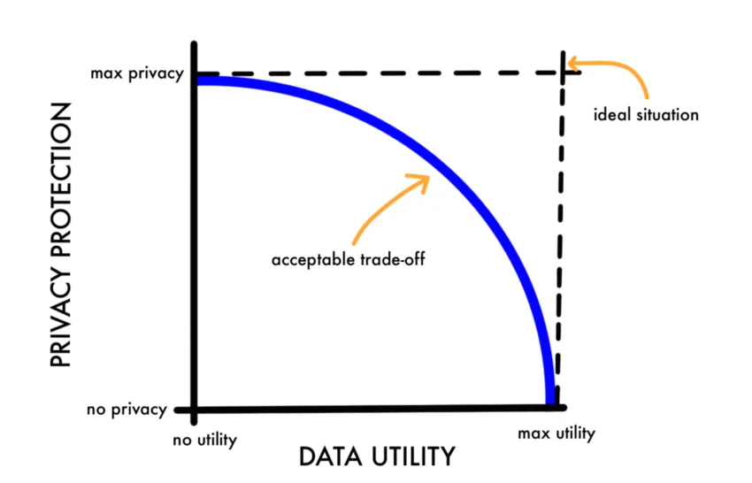
Conclusion
There is always a trade-off between privacy vs utility.

Slide 42

Thank You!
Let’s collaborate! Please reach out to:
alan_tang@tech.gov.sg

